Slide 1
Single-source shortest path

Slide 2
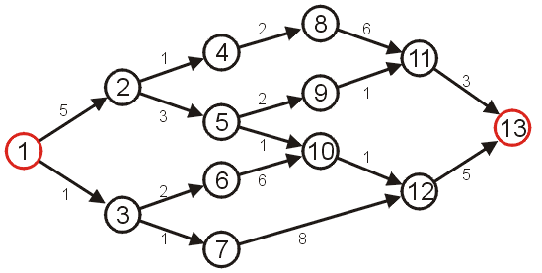
Shortest Path
Given a weighted directed graph, one common problem is finding the shortest path between two given vertices
Recall that in a weighted graph, the length of a path is the sum of the weights of each of the edges in that path
Given the graph, suppose we wish to find the shortest path from vertex 1 to vertex 13

Slide 3
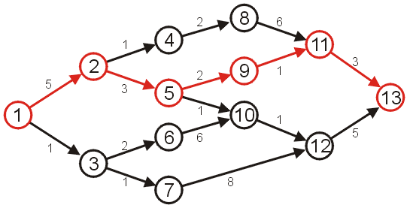
Shortest Path
After some consideration, we may determine that the shortest path is as follows, with length 14
Other paths exists, but they are longer

Slide 4
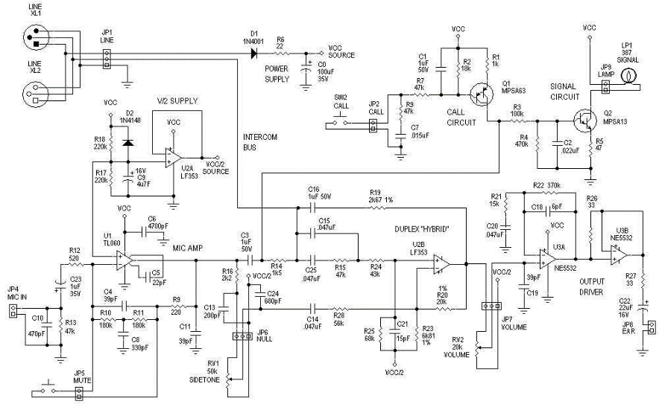
Applications
one application is circuit design: the time it takes for a change in input to affect an output depends on the shortest path

Slide 5
Applications
The Internet is a collection of interconnected computer networks
Information is passed through packets
Packets are passed from the source, through routers, to their destination
Routers are connected to either:
individual computers, or
other routers
These may be represented as graphs

Slide 6

Applications
A visualization of the graph of the routers and their various connections through a portion of the Internet

Slide 7
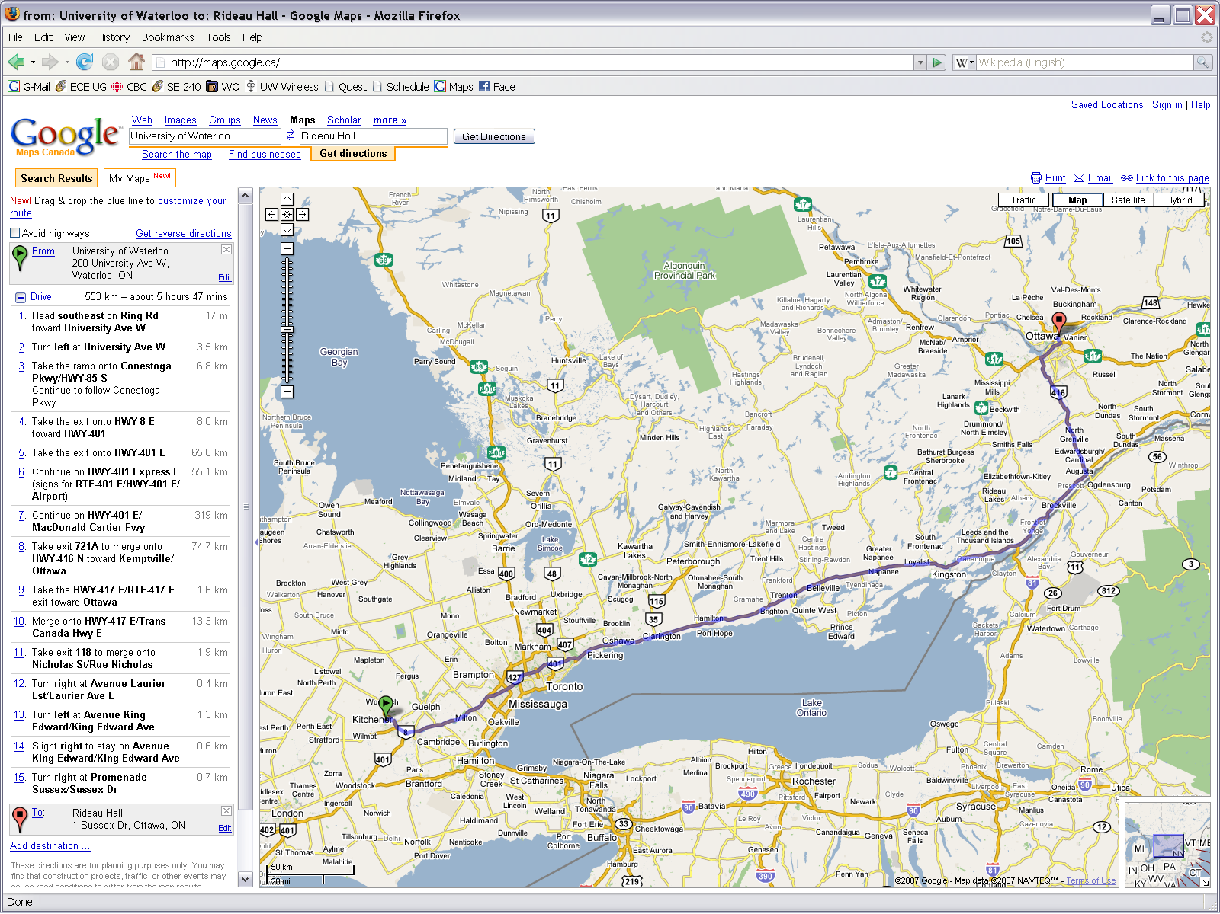
Applications
In software engineering, one obvious problem is finding the shortest route between to points on a map
Shortest path, however, need not refer to distance...

Slide 8
Applications
The shortest path using distance as a metric is obvious, however, a driver may be more interested in minimizing time
For example, using the 407 may be preferable to using the 401 during rush hour, however, there is an added cost
A company will be interested in minimizing the cost which includes the following factors:
salary of the truck driver (overtime?)
possible tolls and administrative costs
bonuses for being early
penalties for being late
cost of fuel

Slide 9
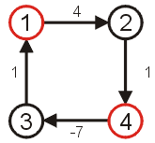
Shortest Path
The goal of this algorithm will be to find the shortest path and its length
We will make the assumption that the weights on all edges is a positive number
Clearly, if we have negative vertices, it may be possible to end up in a cycle whereby each pass through the cycle decreases the total length
Thus, a shortest length would be undefined for such a graph
Consider the shortest path from vertex 1 to 4...

Slide 10
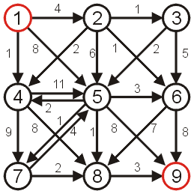
Shortest Path
Consider the following graph
All edges have positive weight
There exists cycles—it is not a DAG

Slide 11
Algorithms
Algorithms for finding the shortest path include:
Dijkstra’s algorithm
A* search algorithm
Bellman-Ford algorithm
BFS

Slide 12
Breadth-First Search
Breadth-first search (BFS) is a general technique for traversing a graph
A BFS traversal of a graph G
Visits all the vertices and edges of G
Determines whether G is connected
Computes the connected components of G
BFS on a graph with n vertices and m edges takes O(n + m ) time
BFS can be further extended to solve other graph problems
Find and report a path with the minimum number of edges between two given vertices
Find a simple cycle, if there is one

Slide 13
BFS Algorithm
The algorithm uses a mechanism for setting and getting “labels” of vertices and edges
Algorithm BFS(G, s)
L₀ ← new empty sequence
L₀.insertLast(s)
setLabel(s, VISITED)
i ← 0
while ¬L_{i}.isEmpty()
L_{i +1} ← new empty sequence
for all v ∈ L_{i}.elements() for all e ∈ G.incidentEdges(v)
if getLabel(e) = UNEXPLORED
w ← opposite(v,e)
if getLabel(w) = UNEXPLORED
setLabel(e, DISCOVERY)
setLabel(w, VISITED)
L_{i +1}.insertLast(w)
else
setLabel(e, CROSS)
i ← i +1

Slide 14
Breadth First Search
2
4
8
s
5
7
3
6
9

Slide 15
Breadth First Search
Shortest path from s
1
2
2
4
8
0
s
5
7
3
6
9
Undiscovered
Discovered
Queue: s
Top of queue
Finished

Slide 16
Breadth First Search
1
2
4
8
0
s
5
7
3
3
6
9
1
Undiscovered
Discovered
Queue: s 2
Top of queue
Finished

Slide 17
Breadth First Search
1
2
4
8
0
s
5
5
7
1
3
6
9
1
Undiscovered
Discovered
Queue: s 2 3
Top of queue
Finished

Slide 18
Breadth First Search
1
2
4
8
0
s
5
7
1
3
6
9
1
Undiscovered
Discovered
Queue: 2 3 5
Top of queue
Finished

Slide 19
Breadth First Search
1
2
2
4
4
8
0
s
5
7
1
3
6
9
1
Undiscovered
Discovered
Queue: 2 3 5
Top of queue
Finished

Slide 20
Breadth First Search
1
2
2
4
8
5 already discovered: don't enqueue
0
s
5
7
1
3
6
9
1
Undiscovered
Discovered
Queue: 2 3 5 4
Top of queue
Finished

Slide 21
Breadth First Search
1
2
2
4
8
0
s
5
7
1
3
6
9
1
Undiscovered
Discovered
Queue: 2 3 5 4
Top of queue
Finished

Slide 22
Breadth First Search
1
2
2
4
8
0
s
5
7
1
3
6
9
1
Undiscovered
Discovered
Queue: 3 5 4
Top of queue
Finished

Slide 23
Breadth First Search
1
2
2
4
8
0
s
5
7
1
3
6
6
9
1
2
Undiscovered
Discovered
Queue: 3 5 4
Top of queue
Finished

Slide 24
Breadth First Search
1
2
2
4
8
0
s
5
7
1
3
6
9
1
2
Undiscovered
Discovered
Queue: 3 5 4 6
Top of queue
Finished

Slide 25
Breadth First Search
1
2
2
4
8
0
s
5
7
1
3
6
9
1
2
Undiscovered
Discovered
Queue: 5 4 6
Top of queue
Finished

Slide 26
Breadth First Search
1
2
2
4
8
0
s
5
7
1
3
6
9
1
2
Undiscovered
Discovered
Queue: 5 4 6
Top of queue
Finished

Slide 27
Breadth First Search
1
2
2
4
8
0
s
5
7
1
3
6
9
1
2
Undiscovered
Discovered
Queue: 4 6
Top of queue
Finished

Slide 28
Breadth First Search
1
2
3
2
4
8
8
0
s
5
7
1
3
6
9
1
2
Undiscovered
Discovered
Queue: 4 6
Top of queue
Finished

Slide 29
Breadth First Search
1
2
3
2
4
8
0
s
5
7
1
3
6
9
1
2
Undiscovered
Discovered
Queue: 4 6 8
Top of queue
Finished

Slide 30
Breadth First Search
1
2
3
2
4
8
0
s
5
7
7
1
3
3
6
9
1
2
Undiscovered
Discovered
Queue: 6 8
Top of queue
Finished

Slide 31
Breadth First Search
1
2
3
2
4
8
0
s
5
7
1
3
3
6
9
9
1
2
3
Undiscovered
Discovered
Queue: 6 8 7
Top of queue
Finished

Slide 32
Breadth First Search
1
2
3
2
4
8
0
s
5
7
1
3
3
6
9
1
2
3
Undiscovered
Discovered
Queue: 6 8 7 9
Top of queue
Finished

Slide 33
Breadth First Search
1
2
3
2
4
8
0
s
5
7
1
3
3
6
9
1
2
3
Undiscovered
Discovered
Queue: 8 7 9
Top of queue
Finished

Slide 34
Breadth First Search
1
2
3
2
4
8
0
s
5
7
1
3
3
6
9
1
2
3
Undiscovered
Discovered
Queue: 7 9
Top of queue
Finished

Slide 35
Breadth First Search
1
2
3
2
4
8
0
s
5
7
1
3
3
6
9
1
2
3
Undiscovered
Discovered
Queue: 7 9
Top of queue
Finished

Slide 36
Breadth First Search
1
2
3
2
4
8
0
s
5
7
1
3
3
6
9
1
2
3
Undiscovered
Discovered
Queue: 7 9
Top of queue
Finished

Slide 37
Breadth First Search
1
2
3
2
4
8
0
s
5
7
1
3
3
6
9
1
2
3
Undiscovered
Discovered
Queue: 7 9
Top of queue
Finished

Slide 38
Breadth First Search
1
2
3
2
4
8
0
s
5
7
1
3
3
6
9
1
2
3
Undiscovered
Discovered
Queue: 9
Top of queue
Finished

Slide 39
Breadth First Search
1
2
3
2
4
8
0
s
5
7
1
3
3
6
9
1
2
3
Undiscovered
Discovered
Queue: 9
Top of queue
Finished

Slide 40
Breadth First Search
1
2
3
2
4
8
0
s
5
7
1
3
3
6
9
1
2
3
Undiscovered
Discovered
Queue: 9
Top of queue
Finished

Slide 41
Breadth First Search
1
2
3
2
4
8
0
s
5
7
1
3
3
6
9
1
2
3
Undiscovered
Discovered
Queue:
Top of queue
Finished

Slide 42
Breadth First Search
1
2
3
2
4
8
0
s
5
7
1
3
3
6
9
1
2
3
Level Graph

Slide 43
Depth-First Search
Can be used to attempt to visit all nodes of a graph in a systematic manner
Works with directed and undirected graphs
Works with weighted and unweighted graphs
depth-first-search
mark vertex as visited
for each adjacent vertex
if unvisited
do a depth-first search on adjacent vertex

Slide 44
Walk-Through
Visited Array
Stack
F
C
A
B
C
D
E
F
G
H
A
B
D
H
G
E
Task: Conduct a depth-first search of the graph starting with node D

Slide 45
Walk-Through
Visited Array
F
C
A
B
C
D | √
E
F
G
H
D
A
B
D
H
G
E
The order nodes are visited:
D
Visit D

Slide 46
Walk-Through
Visited Array
F
C
A
B
C
D | √
E
F
G
H
D
A
B
D
H
G
E
The order nodes are visited:
D
Consider nodes adjacent to D, decide to visit C first (Rule: visit adjacent nodes in alphabetical order)

Slide 47
Walk-Through
Visited Array
F
C
A
B
C | √
D | √
E
F
G
H
C
D
A
B
D
H
G
E
The order nodes are visited:
D, C
Visit C

Slide 48
Walk-Through
Visited Array
F
C
A
B
C | √
D | √
E
F
G
H
C
D
A
B
D
H
G
E
The order nodes are visited:
D, C
No nodes adjacent to C; cannot continue ➔ backtrack, i.e., pop stack and restore previous state

Slide 49
Walk-Through
Visited Array
F
C
A
B
C | √
D | √
E
F
G
H
D
A
B
D
H
G
E
The order nodes are visited:
D, C
Back to D – C has been visited, decide to visit E next

Slide 50
Walk-Through
Visited Array
F
C
A
B
C | √
D | √
E | √
F
G
H
E
D
A
B
D
H
G
E
The order nodes are visited:
D, C, E
Back to D – C has been visited, decide to visit E next

Slide 51
Walk-Through
Visited Array
F
C
A
B
C | √
D | √
E | √
F
G
H
E
D
A
B
D
H
G
E
The order nodes are visited:
D, C, E
Only G is adjacent to E

Slide 52
Walk-Through
Visited Array
F
C
A
B
C | √
D | √
E | √
F
G | √
H
G
E
D
A
B
D
H
G
E
The order nodes are visited:
D, C, E, G
Visit G

Slide 53
Walk-Through
Visited Array
F
C
A
B
C | √
D | √
E | √
F
G | √
H
G
E
D
A
B
D
H
G
E
The order nodes are visited:
D, C, E, G
Nodes D and H are adjacent to G. D has already been visited. Decide to visit H.

Slide 54
Walk-Through
Visited Array
F
C
A
B
C | √
D | √
E | √
F
G | √
H | √
H
G
E
D
A
B
D
H
G
E
The order nodes are visited:
D, C, E, G, H
Visit H

Slide 55
Walk-Through
Visited Array
F
C
A
B
C | √
D | √
E | √
F
G | √
H | √
H
G
E
D
A
B
D
H
G
E
The order nodes are visited:
D, C, E, G, H
Nodes A and B are adjacent to H. Decide to visit A next.

Slide 56
Walk-Through
Visited Array
F
C
A | √
B
C | √
D | √
E | √
F
G | √
H | √
A
H
G
E
D
A
B
D
H
G
E
The order nodes are visited:
D, C, E, G, H, A
Visit A

Slide 57
Walk-Through
Visited Array
F
C
A | √
B
C | √
D | √
E | √
F
G | √
H | √
A
H
G
E
D
A
B
D
H
G
E
The order nodes are visited:
D, C, E, G, H, A
Only Node B is adjacent to A. Decide to visit B next.

Slide 58
Walk-Through
Visited Array
F
C
A | √
B | √
C | √
D | √
E | √
F
G | √
H | √
B
A
H
G
E
D
A
B
D
H
G
E
The order nodes are visited:
D, C, E, G, H, A, B
Visit B

Slide 59
Walk-Through
Visited Array
F
C
A | √
B | √
C | √
D | √
E | √
F
G | √
H | √
A
H
G
E
D
A
B
D
H
G
E
The order nodes are visited:
D, C, E, G, H, A, B
No unvisited nodes adjacent to B. Backtrack (pop the stack).

Slide 60
Walk-Through
Visited Array
F
C
A | √
B | √
C | √
D | √
E | √
F
G | √
H | √
H
G
E
D
A
B
D
H
G
E
The order nodes are visited:
D, C, E, G, H, A, B
No unvisited nodes adjacent to A. Backtrack (pop the stack).

Slide 61
Walk-Through
Visited Array
F
C
A | √
B | √
C | √
D | √
E | √
F
G | √
H | √
G
E
D
A
B
D
H
G
E
The order nodes are visited:
D, C, E, G, H, A, B
No unvisited nodes adjacent to H. Backtrack (pop the stack).

Slide 62
Walk-Through
Visited Array
F
C
A | √
B | √
C | √
D | √
E | √
F
G | √
H | √
E
D
A
B
D
H
G
E
The order nodes are visited:
D, C, E, G, H, A, B
No unvisited nodes adjacent to G. Backtrack (pop the stack).

Slide 63
Walk-Through
Visited Array
F
C
A | √
B | √
C | √
D | √
E | √
F
G | √
H | √
D
A
B
D
H
G
E
The order nodes are visited:
D, C, E, G, H, A, B
No unvisited nodes adjacent to E. Backtrack (pop the stack).

Slide 64
Walk-Through
Visited Array
F
C
A | √
B | √
C | √
D | √
E | √
F
G | √
H | √
D
A
B
D
H
G
E
The order nodes are visited:
D, C, E, G, H, A, B
F is unvisited and is adjacent to D. Decide to visit F next.

Slide 65
Walk-Through
Visited Array
F
C
A | √
B | √
C | √
D | √
E | √
F | √
G | √
H | √
F
D
A
B
D
H
G
E
The order nodes are visited:
D, C, E, G, H, A, B, F
Visit F

Slide 66
Walk-Through
Visited Array
F
C
A | √
B | √
C | √
D | √
E | √
F | √
G | √
H | √
D
A
B
D
H
G
E
The order nodes are visited:
D, C, E, G, H, A, B, F
No unvisited nodes adjacent to F. Backtrack.

Slide 67
Walk-Through
Visited Array
F
C
A | √
B | √
C | √
D | √
E | √
F | √
G | √
H | √
A
B
D
H
G
E
The order nodes are visited:
D, C, E, G, H, A, B, F
No unvisited nodes adjacent to D. Backtrack.

Slide 68
Walk-Through
Visited Array
F
C
A | √
B | √
C | √
D | √
E | √
F | √
G | √
H | √
A
B
D
H
G
E
The order nodes are visited:
D, C, E, G, H, A, B, F
Stack is empty. Depth-first traversal is done.

Slide 69
Depth-First Search
A
B
C
D
E
F
G

Slide 70
Depth-First Search
v
A
B
C
D
E
F
G
A

Slide 71
Depth-First Search
v
A
B
C
D
E
F
G
A

Slide 72
Depth-First Search
v
A
v
B
C
D
E
F
G
A B

Slide 73
Depth-First Search
v
A
v
B
C
D
E
F
G
A B

Slide 74
Depth-First Search
v
A
v
B
C
D
E
F
G
A B

Slide 75
Depth-First Search
v
A
v
B
C
v
D
E
F
G
A B D

Slide 76
Depth-First Search
v
A
v
B
C
v
D
E
F
G
A B D

Slide 77
Depth-First Search
v
A
v
B
C
v
D
E
F
G
A B D

Slide 78
Depth-First Search
v
A
v
B
C
v
D
E
v
F
G
A B D E

Slide 79
Depth-First Search
v
A
v
B
C
v
D
E
v
F
G
A B D E

Slide 80
Depth-First Search
v
A
v
B
C
v
D
E
v
F
G
A B D E

Slide 81
Depth-First Search
v
A
v
B
C
v
D
E
F
G
A B D E

Slide 82
Depth-First Search
v
A
v
B
C
v
D
E
v
F
G
A B D E

Slide 83
Depth-First Search
v
A
v
B
C
v
D
E
v
F
G
A B D E

Slide 84
Depth-First Search
v
A
v
B
C
v
D
E
v
F
G
A B D E

Slide 85
Depth-First Search
v
A
v
B
C
v
D
E
v
F
G
v
A B D E F

Slide 86
Depth-First Search
v
A
v
B
C
v
D
E
v
F
G
v
A B D E F

Slide 87
Depth-First Search
v
A
v
B
C
v
D
E
v
F
G
v
A B D E F

Slide 88
Depth-First Search
v
A
v
v
B
C
v
D
E
v
F
G
v
A B D E F C

Slide 89
Depth-First Search
v
A
v
v
B
C
v
D
E
v
F
G
v
A B D E F C

Slide 90
Depth-First Search
v
A
v
v
B
C
v
D
E
v
F
G
v
A B D E F C

Slide 91
Depth-First Search
v
A
v
v
B
C
v
D
E
v
F
G
v
A B D E F C

Slide 92
Depth-First Search
v
A
v
v
B
C
v
v
v
D
E
F
G
v
A B D E F C G

Slide 93
Depth-First Search
v
A
v
v
B
C
v
v
v
D
E
F
G
v
A B D E F C G

Slide 94
Depth-First Search
v
A
v
v
B
C
v
v
v
D
E
F
G
v
A B D E F C G

Slide 95
Depth-First Search
v
A
v
v
B
C
v
v
v
D
E
F
G
v
A B D E F C G

Slide 96
Depth-First Search
v
A
v
v
B
C
v
v
v
D
E
F
G
v
A B D E F C G

Slide 97
Depth-First Search
v
A
v
v
B
C
v
v
v
D
E
F
G
v
A B D E F C G

Slide 98
Depth-First Search
v
A
v
v
B
C
v
v
v
D
E
F
G
v
A B D E F C G

Slide 99
Depth-First Search
v
A
v
v
B
C
v
v
v
D
E
F
G
v
A B D E F C G

Slide 100
Depth-First Search
A
B
C
D
E
F
G
A B D E F C G

Slide 101
Time and Space Complexity for Depth-First Search
Time Complexity
Adjacency Lists
Each node is marked visited once
Each node is checked for each incoming edge
O (v + e)
Adjacency Matrix
Have to check all entries in matrix: O(n²)
Space Complexity
Stack to handle nodes as they are explored
Worst case: all nodes put on stack (if graph is linear)
O(n)

Slide 102

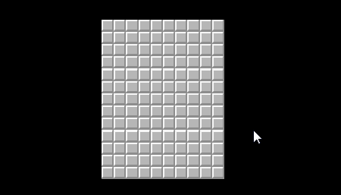
The “Flood Fill” Algorithm
A recursive graphics algorithm used to fill in irregular-shaped regions with a solid color

Slide 103
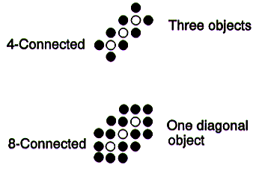

A flood-fill algorithm
void fill( int x, int y, int interiorcolor, int newcolor )
{ //Check boundary crossing
if ( get_pixel( x, y ) == interiorcolor )
{
put_pixel( x, y, newcolor );
fill( x -1, y, interiorcolor, newcolor );
fill( x+1, y, interiorcolor, newcolor );
fill( x, y -1, interiorcolor, newcolor );
fill( x, y+1, interiorcolor, newcolor );
}
}

Slide 104

A flood-fill algorithm
Notes:
void fill(int x,int y,int r, int c,char p)
{
if(x>=r || x<0 || y>=c || y<0)
{
return;
}
if(a[x][y]==p || a[x][y]=='#')
{
return;
}
a[x][y] = '#';
fill(x-1,y,r,c,p);
fill(x,y-1,r,c,p);
fill(x,y+1,r,c,p);
fill(x+1,y,r,c,p);
}

Slide 105
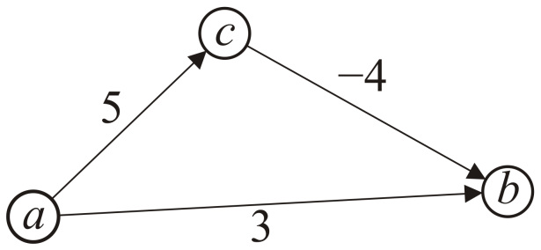
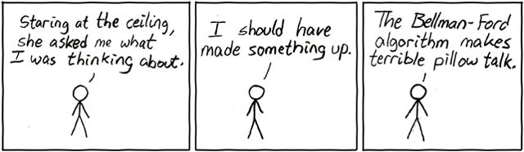
Negative Weights
If some of the edges have negative weight, so long as there are no cycles with negative weight, the Bellman-Ford algorithm will find the minimum distance
It is slower than Dijkstra’s algorithm

Slide 106
π: nil
d: 0
π: nil
d: ∞
A
2
B
-1
π: nil
d: ∞
2
1
C
-3
4
5
1
-1
D
E
4
π: nil
d: ∞
π: nil
d: ∞

Slide 107
π: nil
d: 0
π: nil A
d: ∞ -1
A
2
B
-1
π: nil A
d: ∞ 2
2
1
C
-3
4
5
1
-1
D
E
4
π: nil A
d: ∞ 4
π: nil
d: ∞

Slide 108
π: nil
d: 0
π: nil A
d: ∞ -1
A
2
B
-1
π: nil A B
d: ∞ 2 0
2
1
C
-3
4
5
1
-1
D
E
4
π: nil A
d: ∞ 4
π: nil C
d: ∞ 3

Slide 109
π: nil
d: 0
π: nil A
d: ∞ -1
A
2
B
-1
π: nil A B
d: ∞ 2 0
2
1
C
-3
4
5
1
-1
D
E
4
π: nil A
d: ∞ 4
π: nil C C
d: ∞ 3 1

Slide 110
π: nil
d: 0
π: nil A E
d: ∞ -1 -2
A
2
B
-1
π: nil A B B
d: ∞ 2 0 -1
2
1
C
-3
4
5
1
-1
D
E
4
π: nil A
d: ∞ 4
π: nil C C
d: ∞ 3 1

Slide 111
The Bellman-Ford Algorithm
Bellman-Ford(G, w, s)
Initialize-Single-Source(G, s)
for i := 1 to |V| - 1 do
for each edge (u, v) ∈ E do
Relax(u, v, w)
for each vertex v ∈ u.adj do
if d[v] > d[u] + w(u, v)
then return False // there is a negative cycle
return True
Relax(u, v, w)
if d[v] > d[u] + w(u, v)
then d[v] := d[u] + w(u, v)
parent[v] := u

Slide 112
Time Complexity
Bellman-Ford(G, w, s)
Initialize-Single-Source(G, s)
for i := 1 to |V| - 1 do
for each edge (u, v) ∈ E do
Relax(u, v, w)
for each vertex v ∈ u.adj do
if d[v] > d[u] + w(u, v)
then return False // there is a negative cycle
return True
O(|V|)
O(|V||E|)
O(|E|)
Time complexity: O(|V||E|)

